Slide 1
Story Telling: Red Wine Quality
INTRODUCTION
The wine quality is an essential factor for wine collectors and wine sellers. In general, complexity, balance, typicity, intensity, and finish are key indicators of wine quality.
This wine quality is known to be affected by climate, weather, temperature, sunlight, growing practices, and winemaking practices. These factors could result in a varied range of wine quality.
So in order to determine which type of wine people tend to prefer we could determine the relationship between the wine’s physicochemical properties and quality ratings based on this data. This understanding would help to understand critical factors to improve wine quality.
Now from the Next Slide we will Explore, how these given Properties would help us to understand critical factors to improve wine quality.

Slide 2
1) What is the distribution of wine quality?
The histogram was created to show how the quality of red wine is spread out, helping answer the question: "What is the distribution of wine quality?“
As shown in Figure, most red wines had a quality rating between 5 and 7. There were only a few wines that were rated very poorly (below a quality of 4) or exceptionally well (above a quality of 8).
This means that most red wines fall in the average or mid-range of quality.

Slide 3
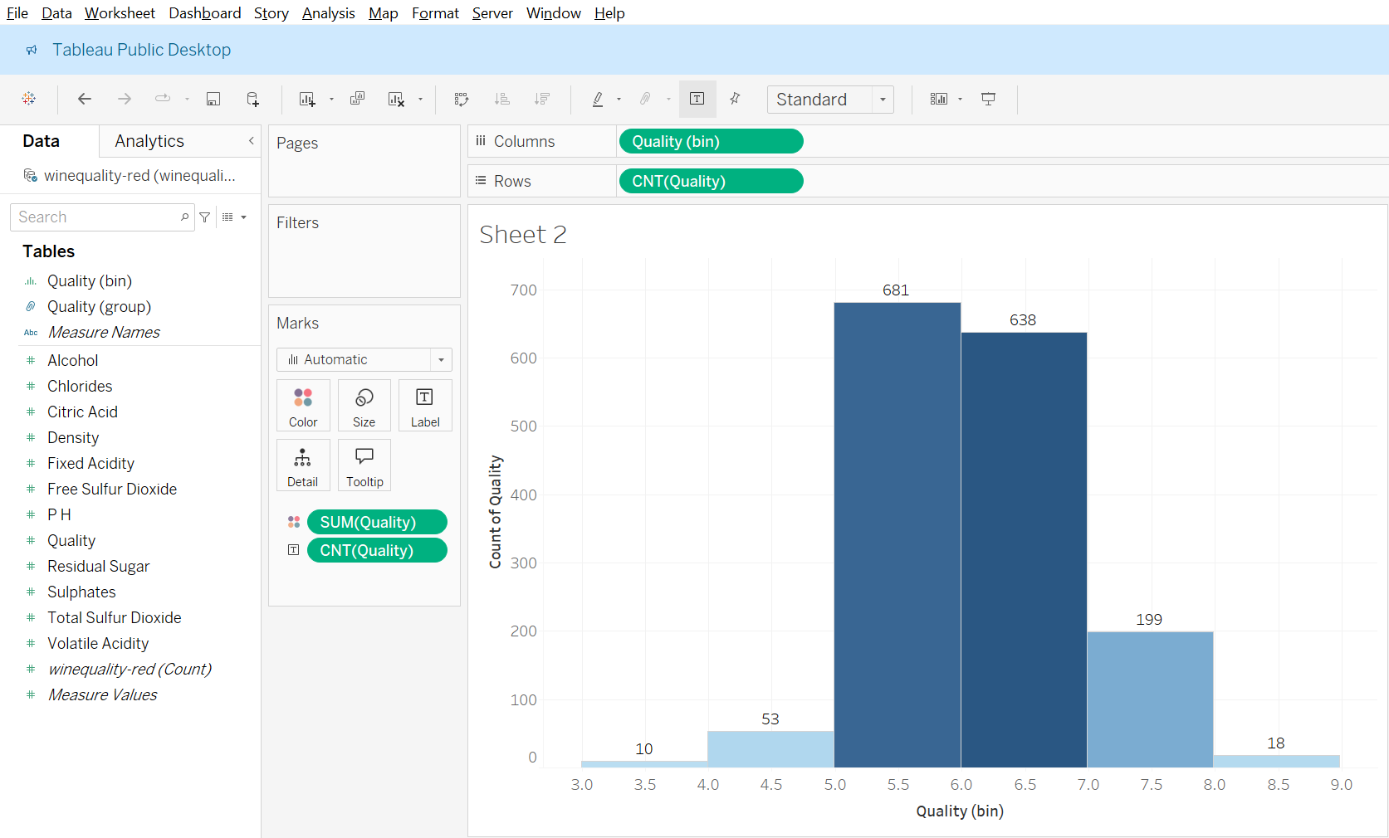
1) What is the distribution of wine quality?

Slide 4
2)What are the differences of variations in properties between low- and high quality wine?
To answer the second question—"What are the differences in properties between low- and high-quality wines?"—a box plot was made to compare how much volatile acidity (a wine property) varied at different quality levels.
As seen in Figure , wines with the highest quality rating (8) had very little variation in their volatile acidity, meaning their acidity levels were consistent. On the other hand, the lowest quality wines (rated 3) had the most variation in acidity, meaning their acidity levels were all over the place.
This suggests that high-quality wines tend to have more stable, consistent acidity levels.

Slide 5
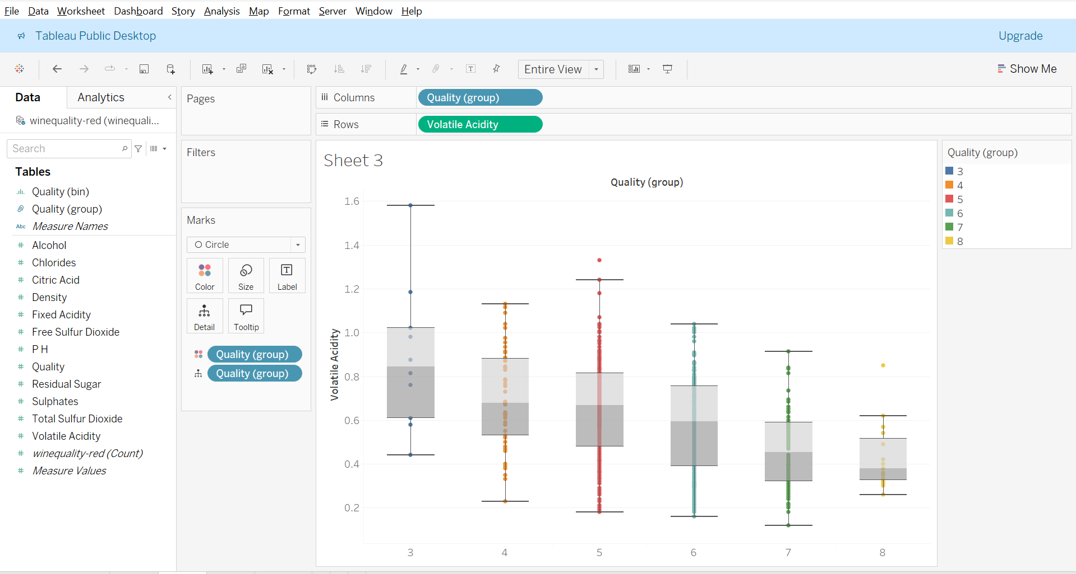
2)What are the differences of variations in properties between low- and high quality wine?

Slide 6
3) What is the good combination of multiple properties for producing a good quality wine?
To answer the question "What is the best combination of properties for making good-quality wine?", a scatter plot was created with color-coding to explore the relationship between three factors: alcohol content, volatile acidity, and wine quality.
As seen in Figure, two reference lines were added for the average values of alcohol content (10) and volatile acidity (0.8). The plot showed a clear pattern: high-quality wines were mostly found in the area where alcohol content was above the average and volatile acidity was below the average. This suggests that people tend to prefer wines with a fruity aroma (which comes from lower acidity) and higher alcohol content.

Slide 7
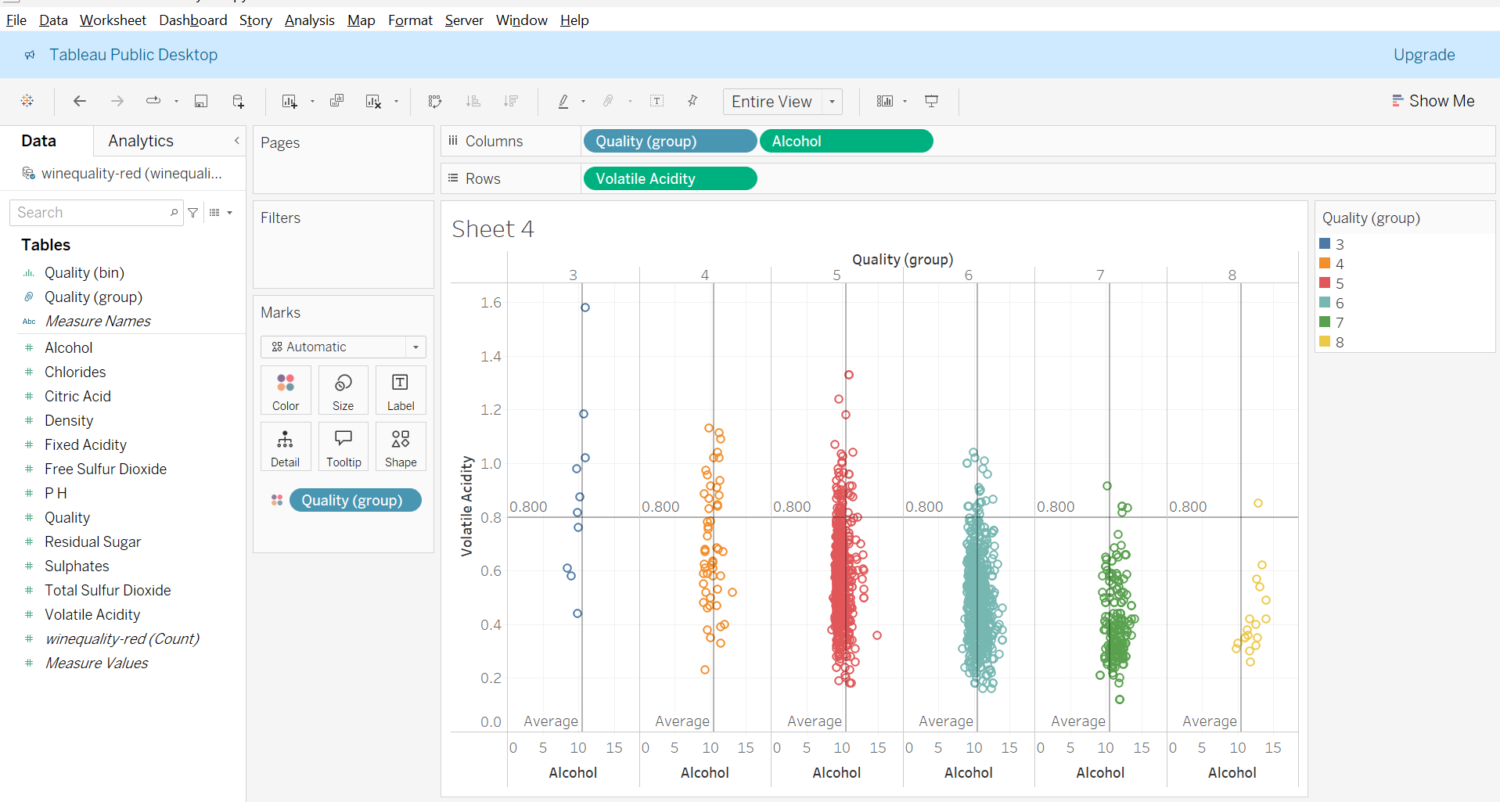
3) What is the good combination of multiple properties for producing a good quality wine?

Slide 8
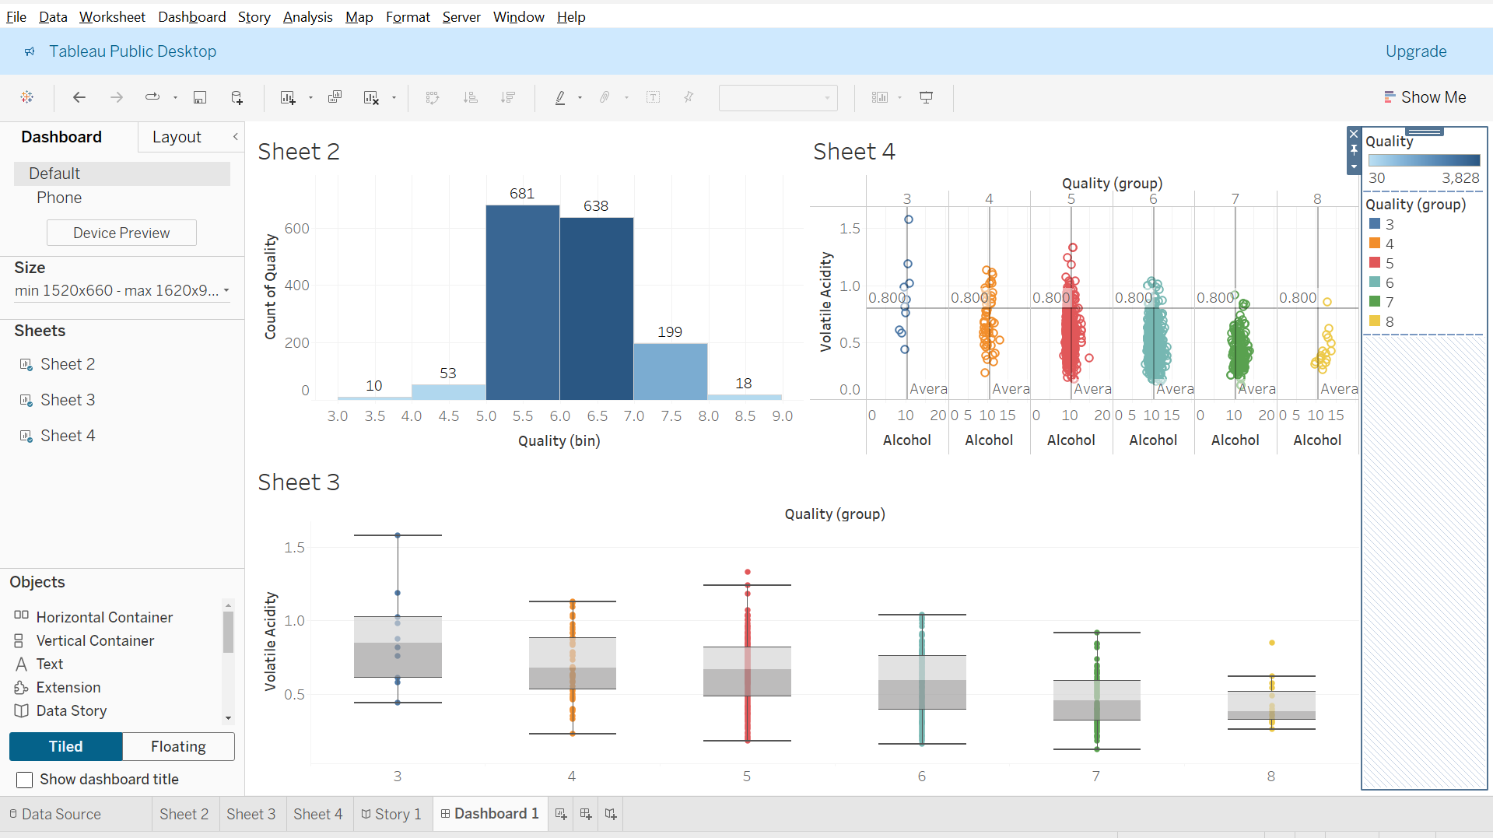

Slide 9


